Slide 1
From Plagiarism to Academic Excellence
Trusted by 15,000 Institutions and 2 Million Instructors in 140 countries
Consultant, Turnitin Korea, Janet Kim (janetkim@turnitin.com)

Slide 2
신속한 계정 등록을 위해
이메일로 Turnitin 계정 신청
(이름, 소속, 이메일 주소)
담당자: 한혜영(hyeyoung@eulji.ac.kr)

Slide 4
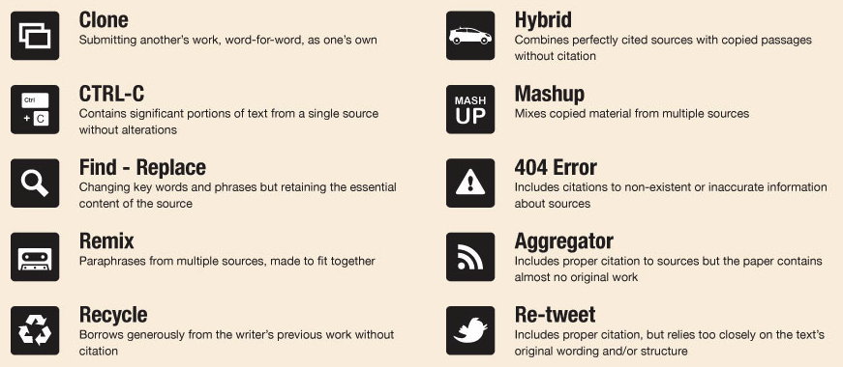
Types of plagiarism
http://turnitin.com/assets/en_us/media/plagiarism_spectrum.php

Slide 5
The largest comparison DB in the world
= The most accurate results
170 million
[1억 7천만]
1 billion
[10억]
65 billion 650억
[매일 천만씩 증가]
journal articles, including Crossref content
student papers and dissertations
current and archived web pages

Slide 6
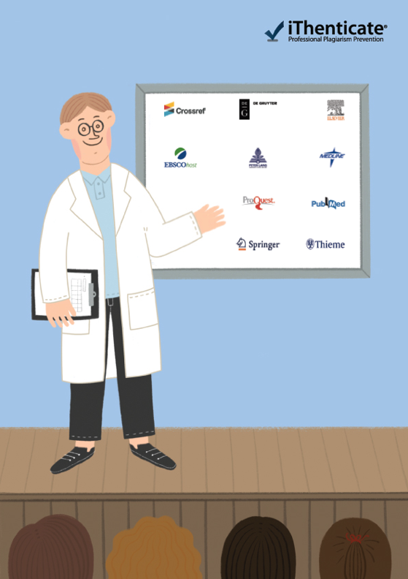

Slide 7
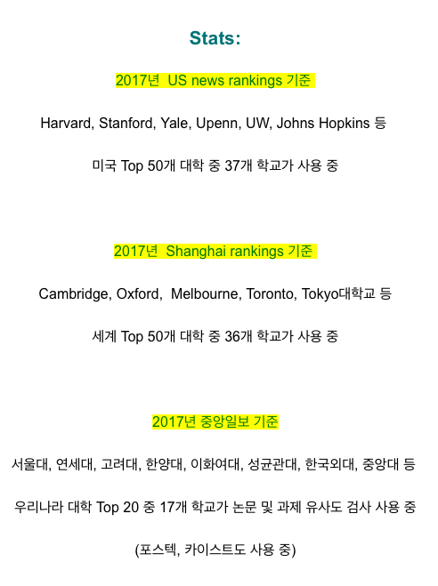
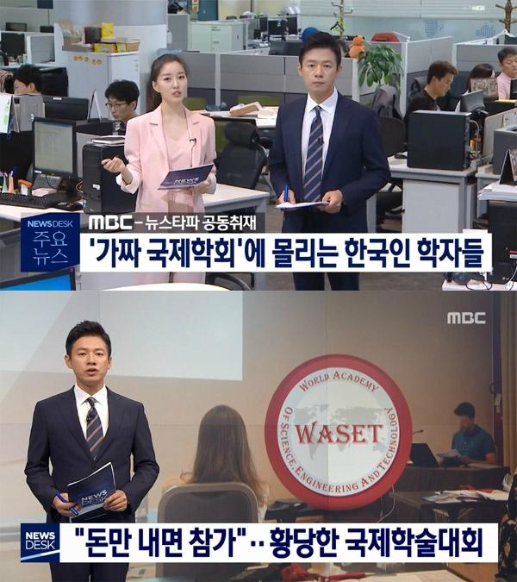

Slide 8
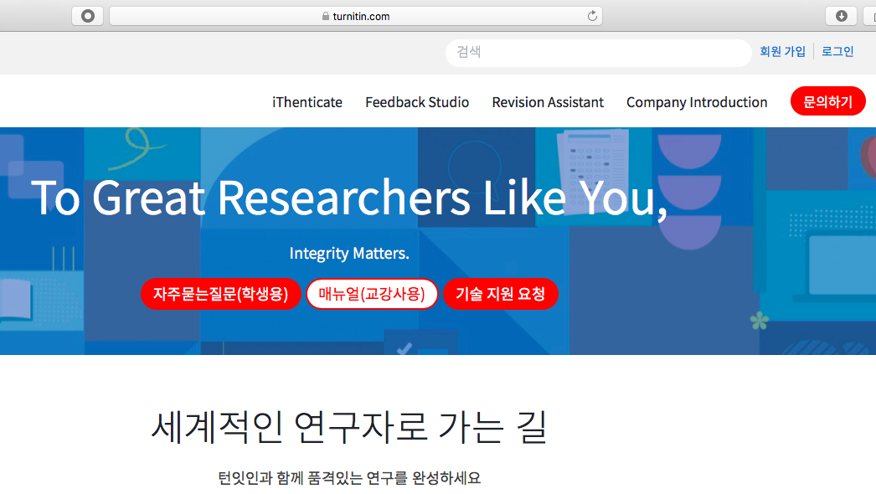
Tutorial for Instructors
Turnitin.com/ko
tiisupport@turnitin.com
- 페이퍼 삭제, 계정 중복 등은 테크 서포트에 직접 요청

Slide 9
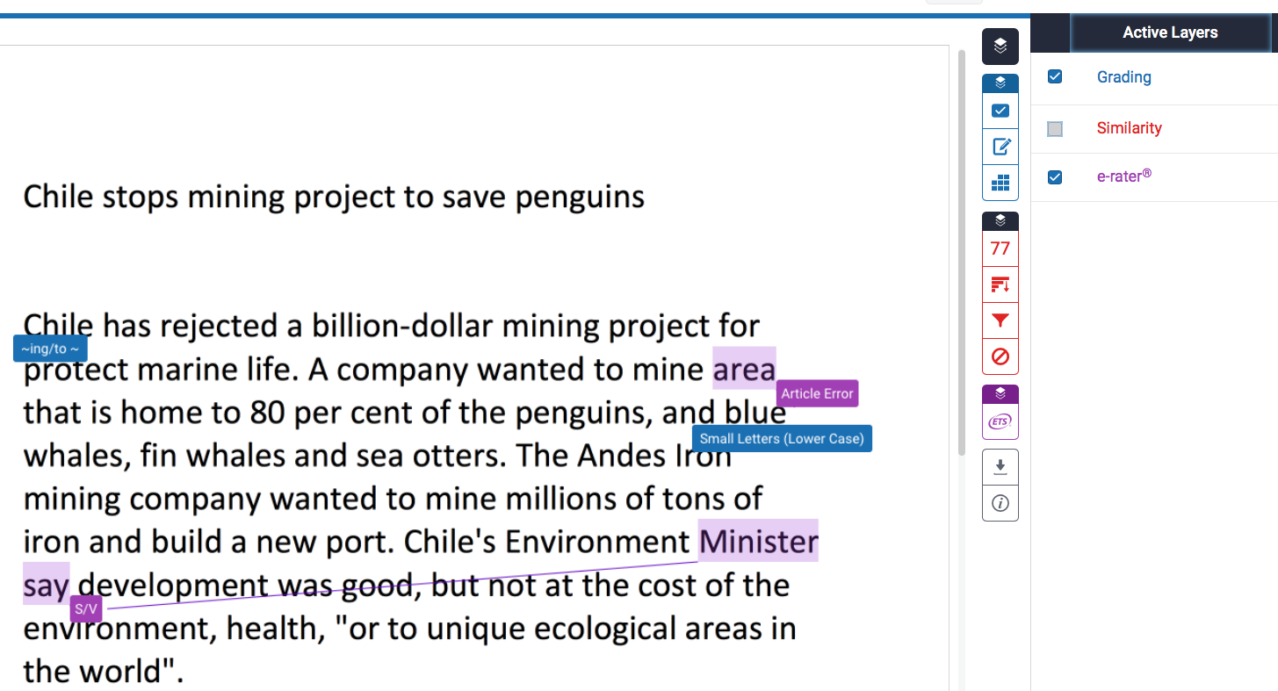
Originality Check (Red)
1) Originality check %: 77 wds out of 100
2) All references (From the highest to the lowest similarity source)
3) Filtering: Quotation marks + references exclusion
4) Undo

Slide 10
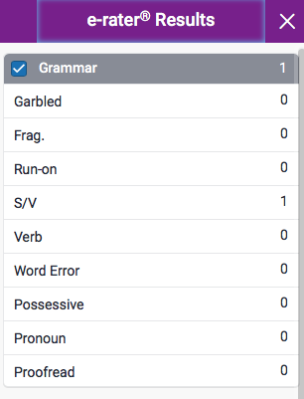
E-rater (Purple)
Download report (with the originality result shown)

Slide 12
5
Upload your paper
Requirements for file upload
: Less than 40MB, at least 20 words of text, Maximum paper length is 400 pages
File types allowed
: Microsoft Word, Excel, PowerPoint, WordPerfect, PostScript, PDF, HTML, RTF, OpenOffice (ODT), Hangul (HWP), Google Docs, and plain text

Slide 13
6

Slide 14
Similarity index (%)
: The percentage of the text in your paper that matched sources in turn it in database.
Result paper: Download → Current View
※ The result pages are on the last section of
the downloaded PDF file.
7
Open layers
Similarity results
Grammar checking
Download results

Slide 15
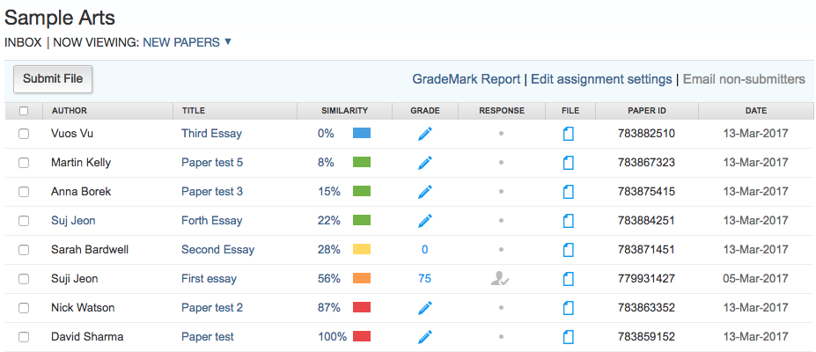
Originality Check (for the whole class)
Blue: No matching text
Green: One word to 24% matching text
Yellow: 25-49% matching text
Orange: 50-74% matching text
Red: 75-100% matching text
© 2016 Turnitin LLC. Company confidential.

Slide 16
Questions?
Contact: Koreasales@turnitin.com
Turnitin.com/ko

